Slide 1

Insights

Slide 2

Objectives
Identify which product categories they are buying the most
To provide comprehensive insights that will improve the company's strategy and meet customer needs.
To uncover the key drivers of customer satisfaction and provide a roadmap to boost NPS and achieve an exceptional satisfaction rate.
Give insights about the shipping performance that can help to make proper decisions.
Show monthly discount trends and average voucher use.
Compare discounts and revenue trends across months.
Highlight regions with highest installment usage.
Analysis of seller behavior, sellers origin, is there enough sellers in each state or not , finding best and worst sellers.

Slide 3
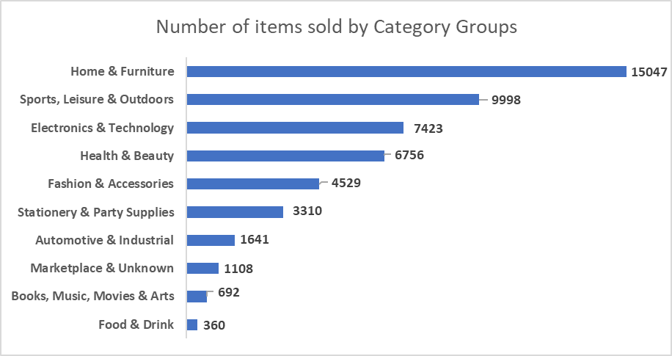
Most sold category

Slide 4



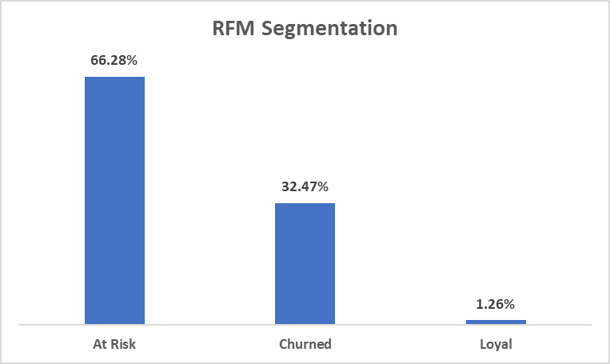
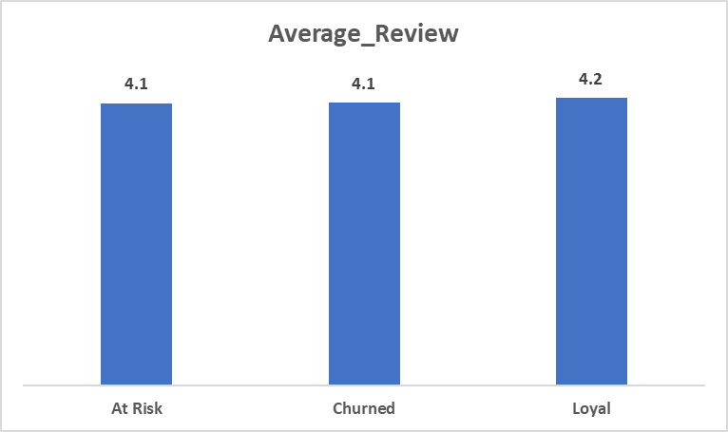
RFM
Recency
Frequency
Monetary value

Slide 5
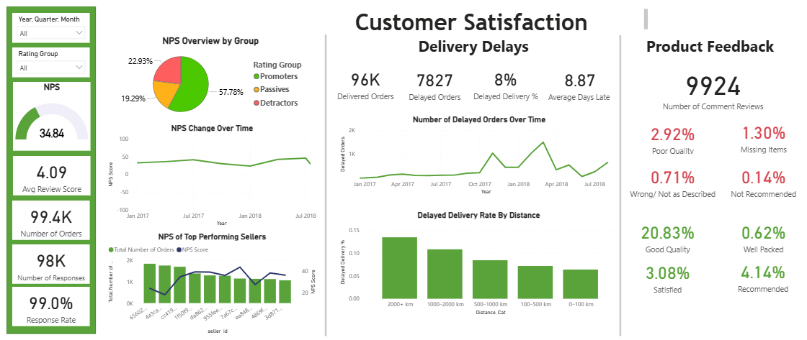
Overview
NPS: Net Promoter Score
NPS: 34.84 (low)
Average Review Score: 4.09
Promoters % = 57.7%
Passive % = 19.2%
Detractor % = 22.2%

Slide 6
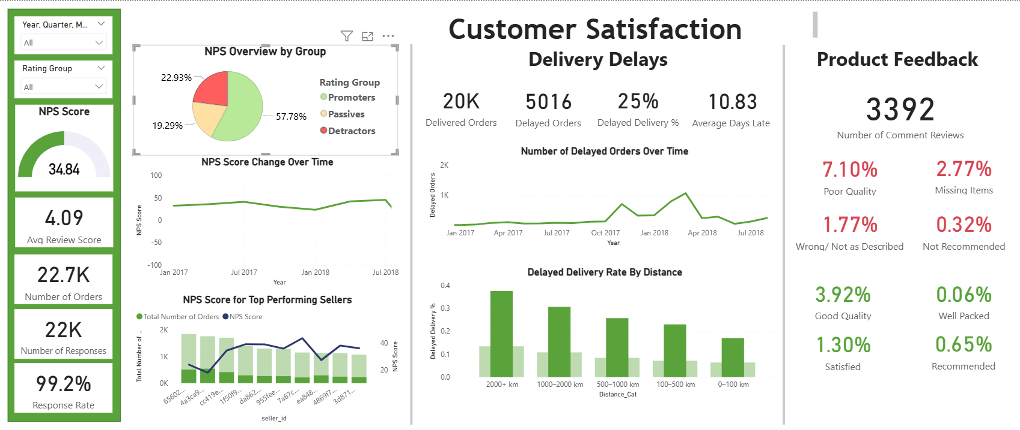
Delivery Delays - Detractors
Delays overtime affect satisfaction:
Spike: Oct 2 - Nov 4, 2017
Brazil's Black Friday and Christmas shopping
Spike: Jan 1 - Mar 1, 2018
Brazil’s Carnival Holidays
Customers locations affect the delivery duration and delays which impact the customer satisfaction

Slide 7
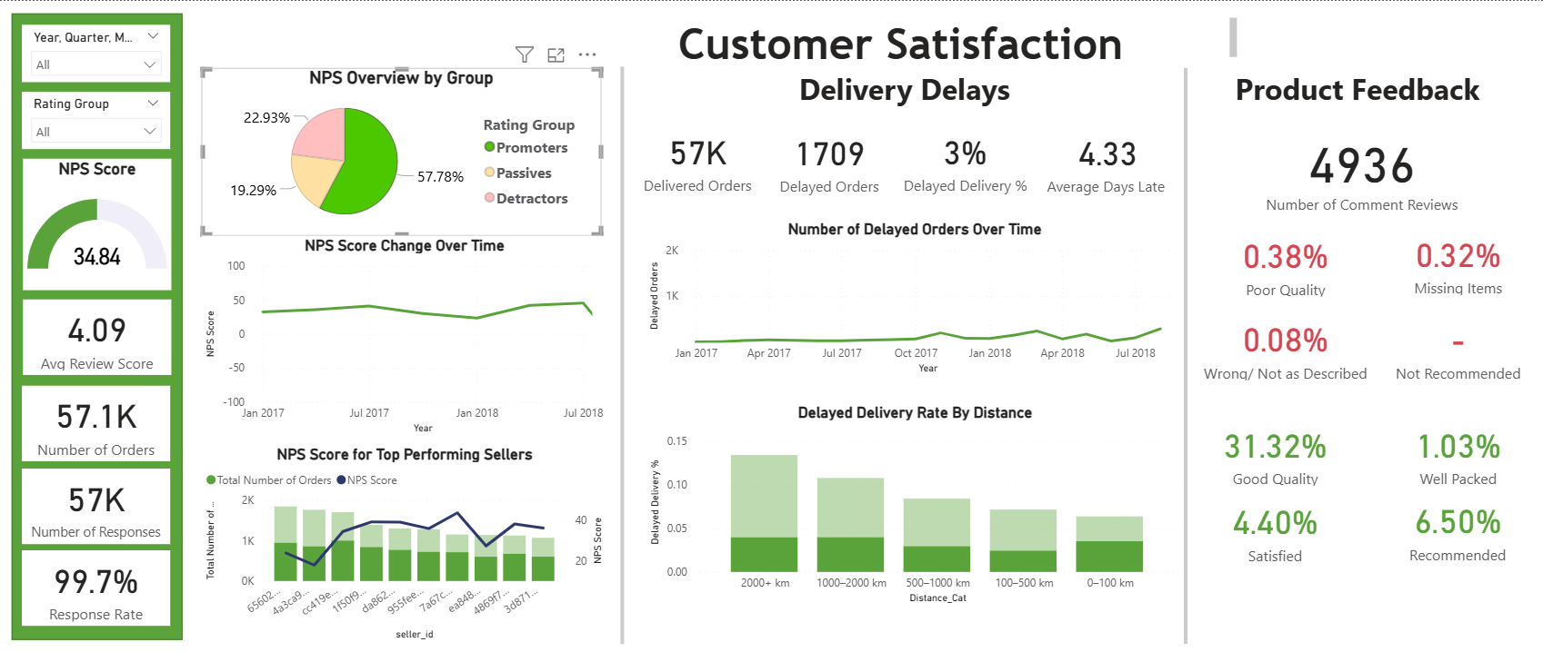
Delivery Delays - Promoters
Reasons of high scores ratings:
Customers are located near the sellers
It takes less time to be delivered
Resulting in fast deliveries and high satisfaction

Slide 8
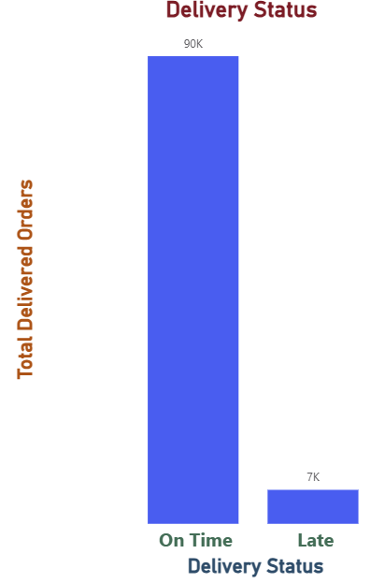
Shipping
How usually it takes the order to be delivered ?
The average delivery days
12 Days
The percentage of late delivered orders
8%

Slide 9
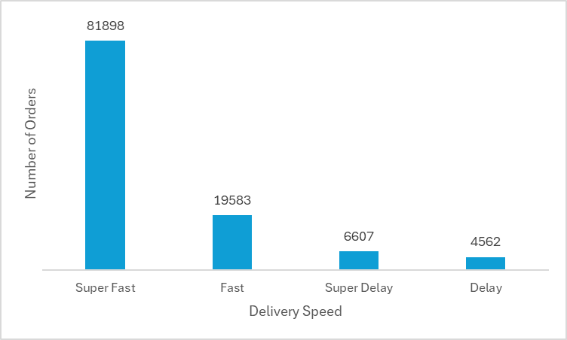
What is the relationship between order volume and delivery speed?
On Time ⟶ Delivery exactly on schedule
Fast ⟶ Delivered early, less than 7 days
Super Fast ⟶ Delivered more than 7 days early
Delayed ⟶ Delivered late, up to 6 days
Super Delayed ⟶ Delivered more than 6 days late

Slide 10
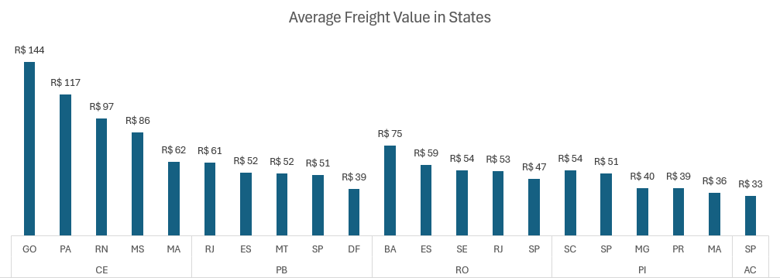
Freight Value

Slide 11
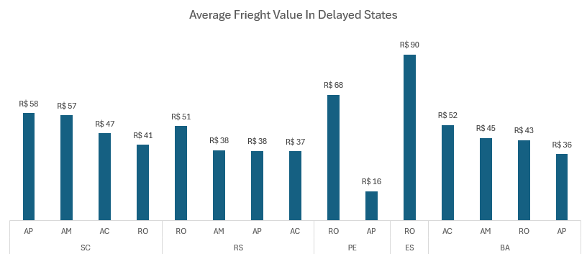
Freight Value

Slide 12
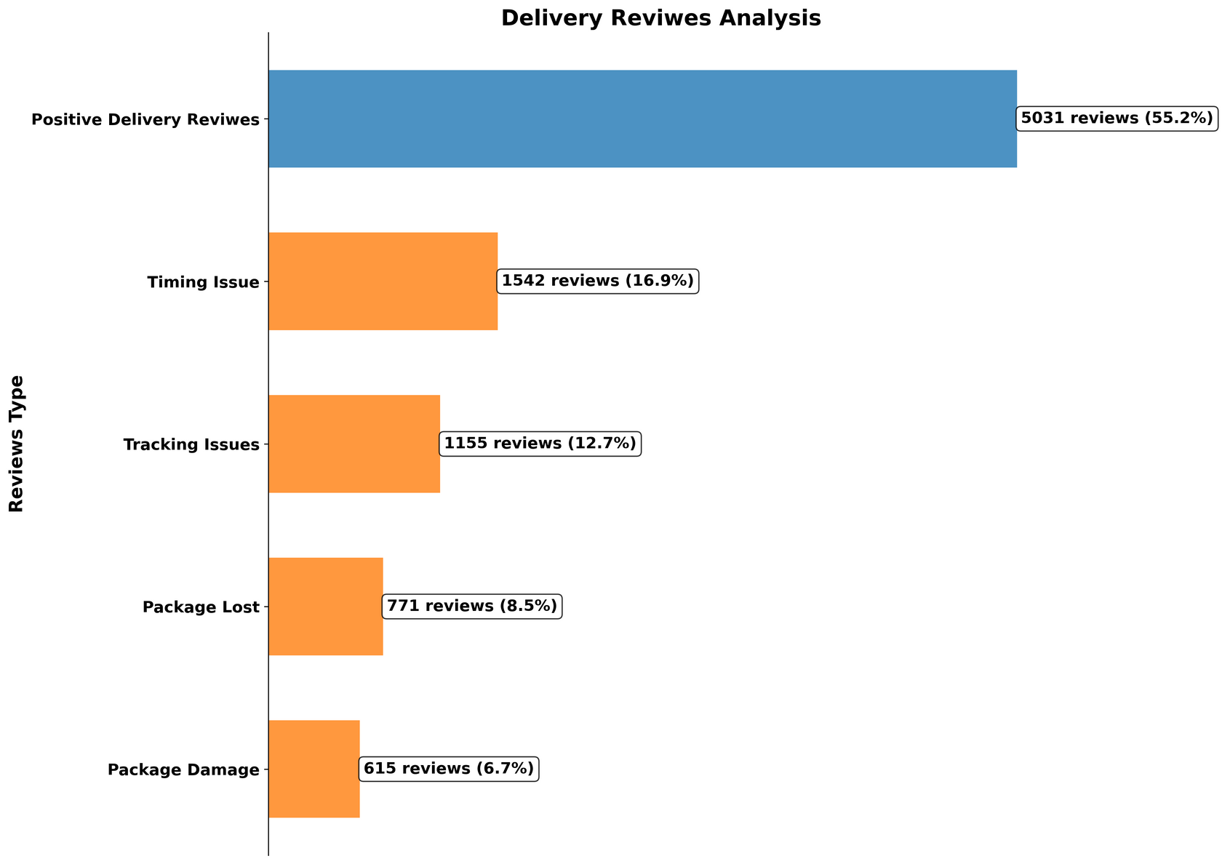
Customers Review

Slide 13

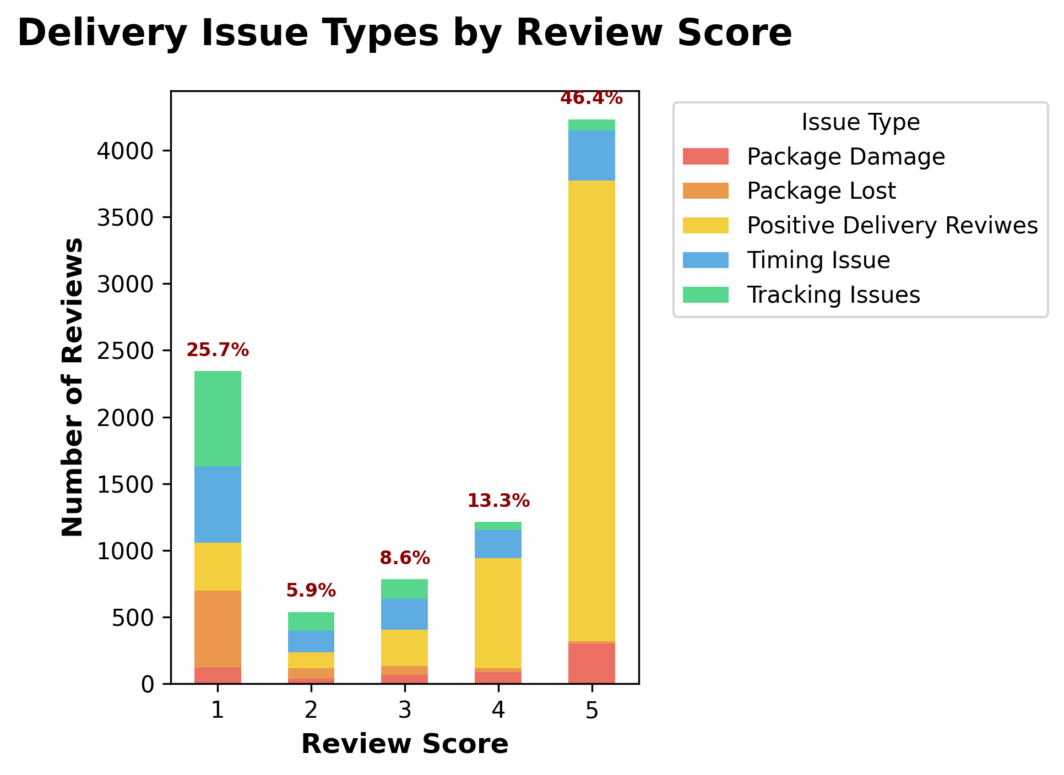
Did the type affect the score?

Slide 14
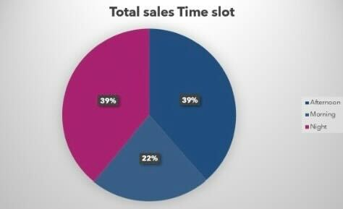
Sales

Slide 15
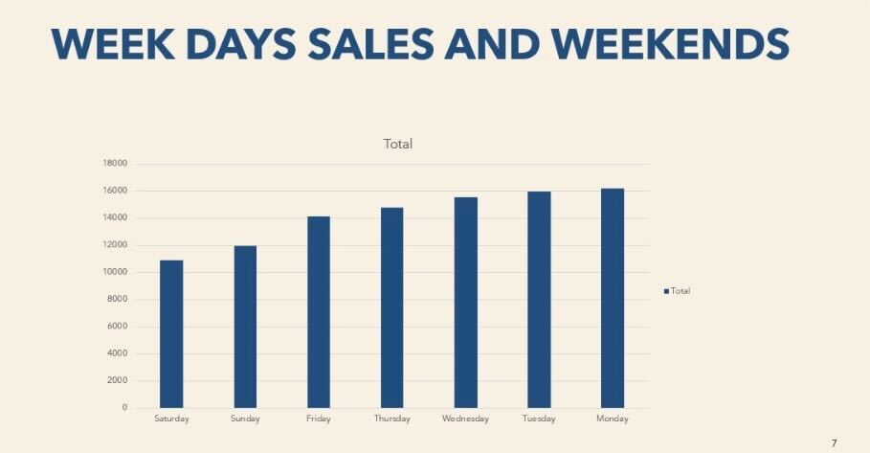
Sales

Slide 16
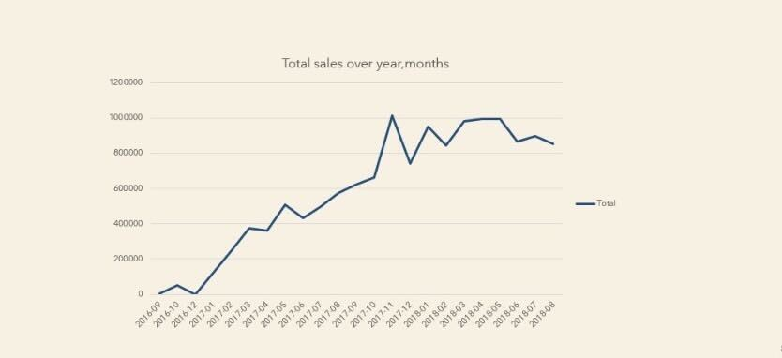
Sales

Slide 17
Discount
Average vouchers used per customer: 2

Slide 19
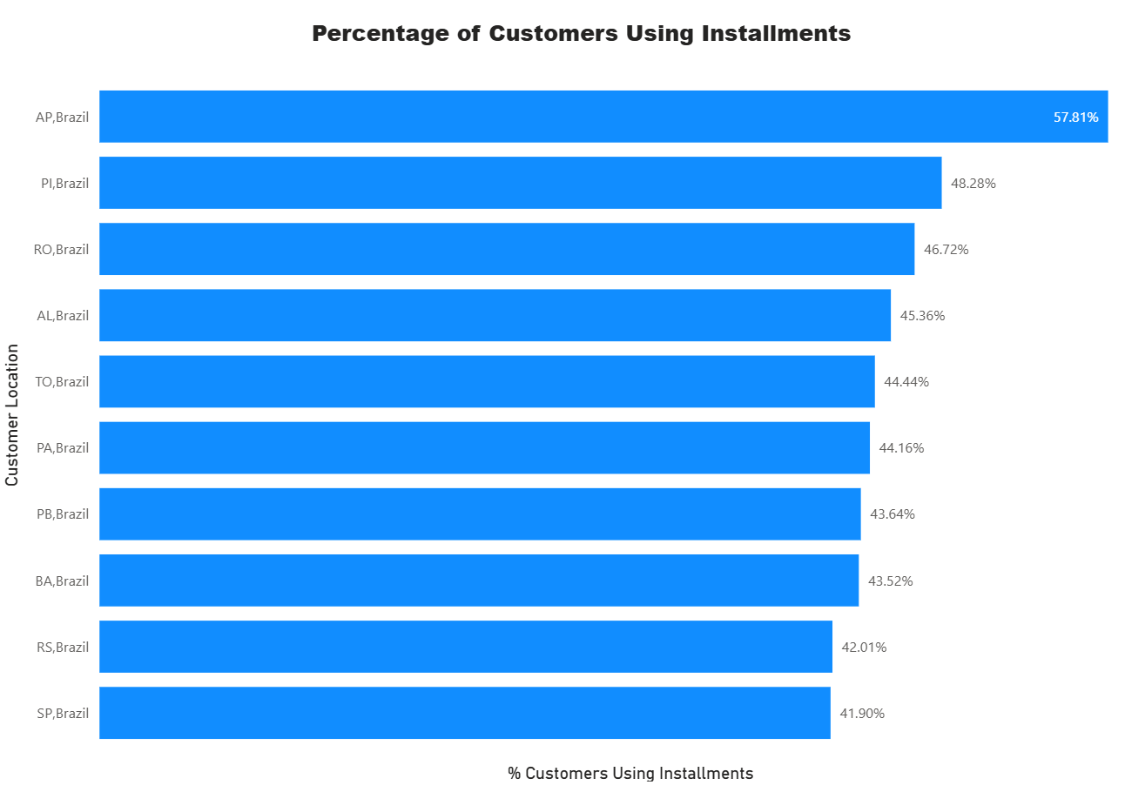
Installments and Customer
The highest percentage of customers is in AP with 57.81%.

Slide 20
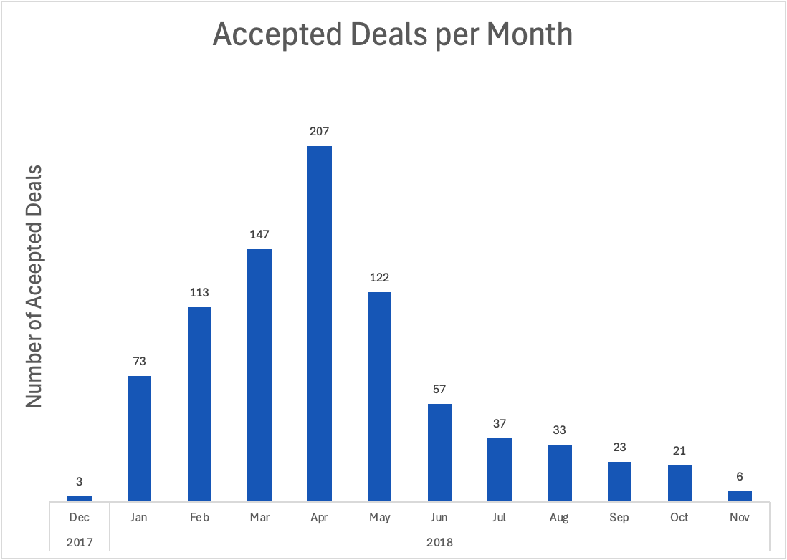
Sellers Behavioral
Home
About
Content
Others
2018
Total Deals
8000
Closed Deals
843
13%
Of the total deals was closed

Slide 21
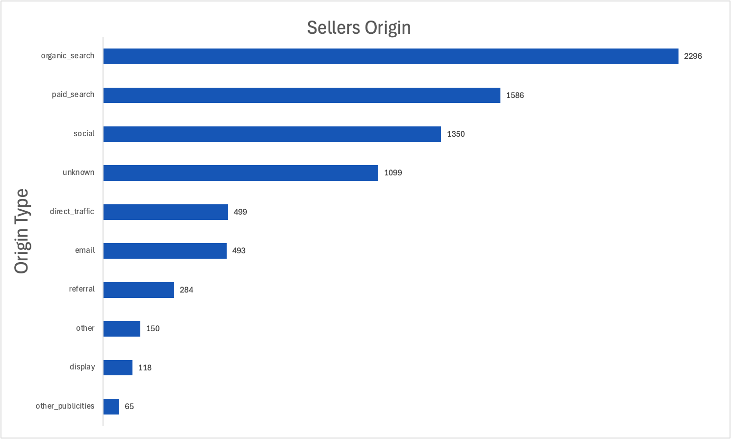
Home
About
Content
Others

Slide 22
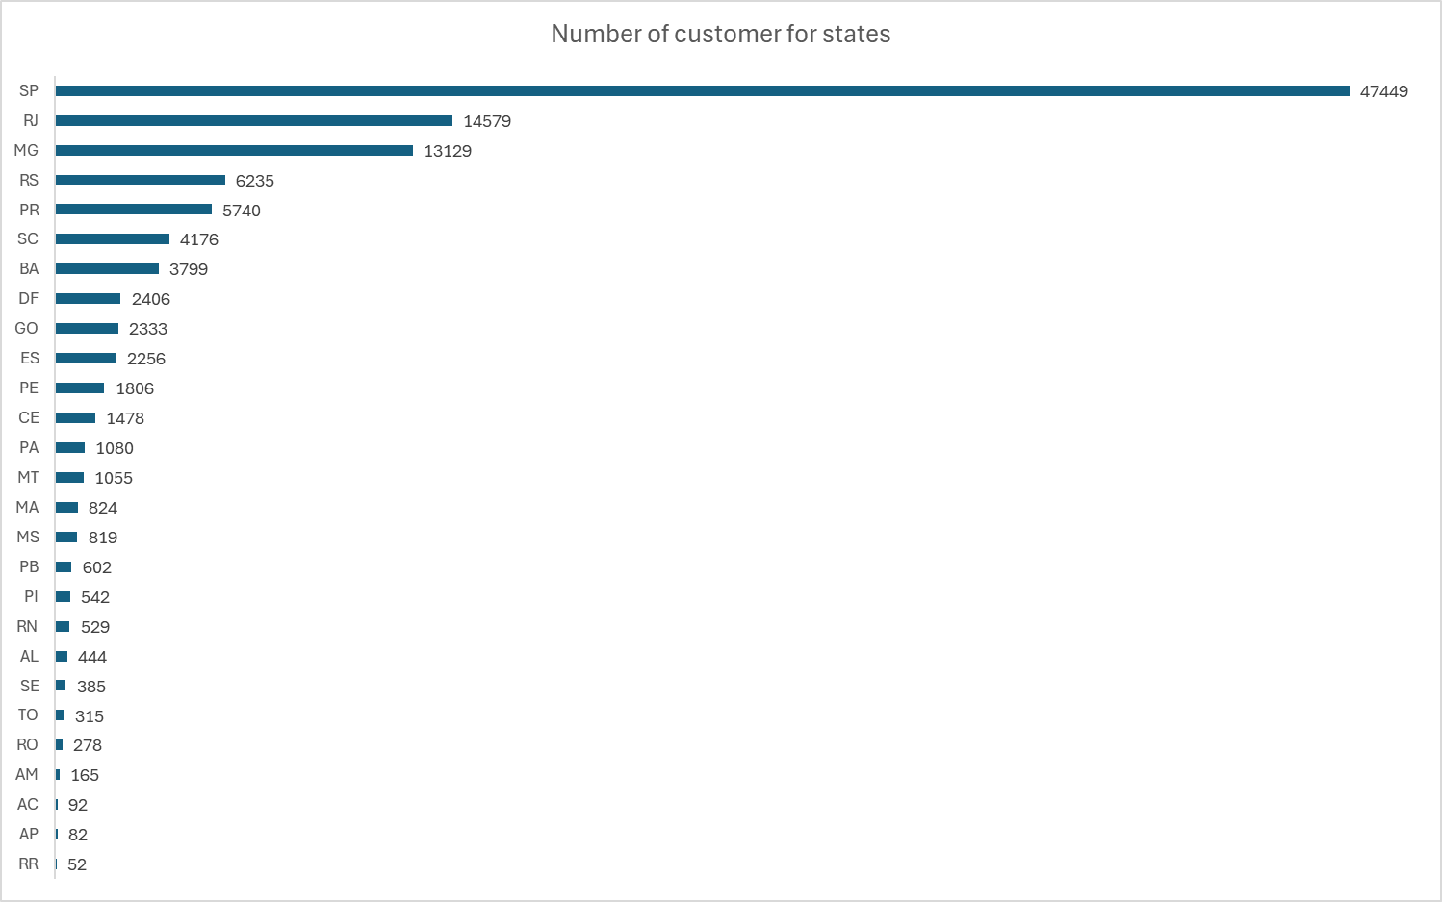
Home
About
Content
Others

Slide 23
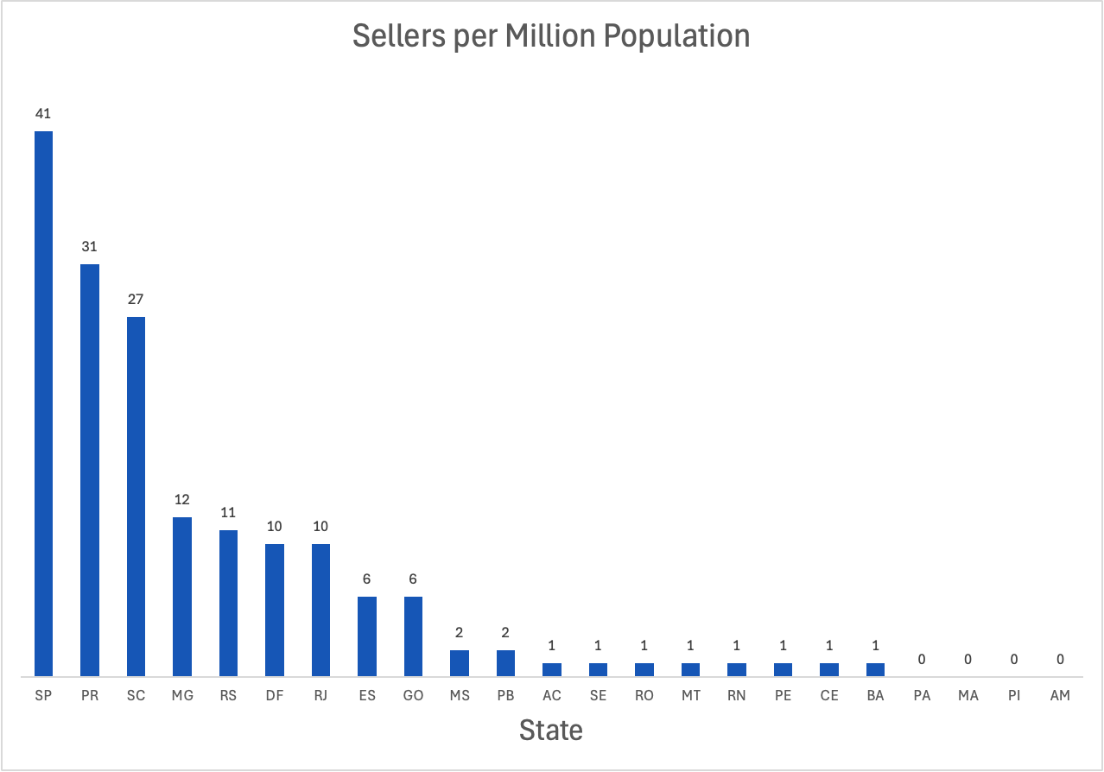
Home
About
Content
Others

Slide 24
Recommendations
Strengthening post-purchase experience (delivery + accuracy + quality) is likely to lift satisfaction first—and only then reveal repeat-purchase behavior we can measure as “loyalty.
Maintain low freight value and strengthen it by ensuring the service quality is good and consistent.
Need more information about the mode of transportation to determine the prices is reasonable or not.
They should improve their services to reach the customers satisfaction.
Revenue peaks around March–August. Promotions have a direct positive impact on the revenue. Use promotions during slow months to increase profits.
Pick new sellers from PA, MA,PI, and AM states.

